Slide 1
Pizza Bot
Link to github Repository: GitHub
Links to trello board / project management tools: Trello Board
You MUST provide evidence showing how the problem has been decomposed, how the components have been developed and trialled, and of how they have been assembled and tested to create a final, working outcome.

Slide 2
Relevant Implications
Explain the relevant implications here. Please watch this video to learn how to do this.
Notes:
Explain the relevant implications here. Then as you work, develop your code, discuss how the implications are being met.

Slide 3
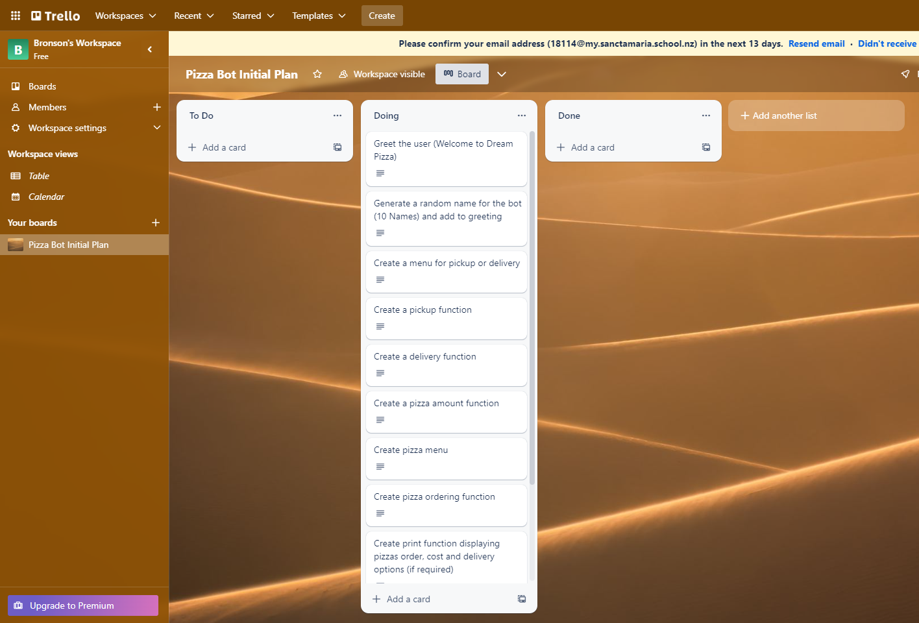
Decomposition
Notes:
Paste screenshots of your initial Trello board / task decomposition on this slide. If you have a long list, you might need to break it up into several columns. Delete this instruction when you are done.

Slide 4
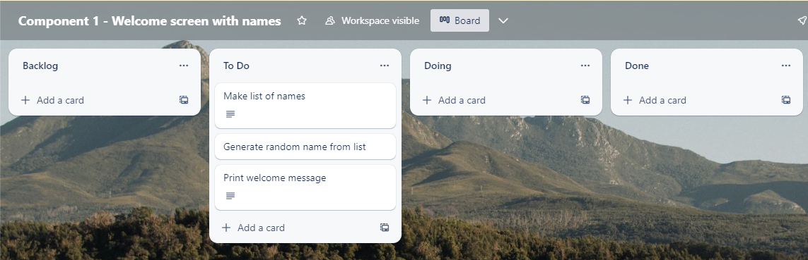
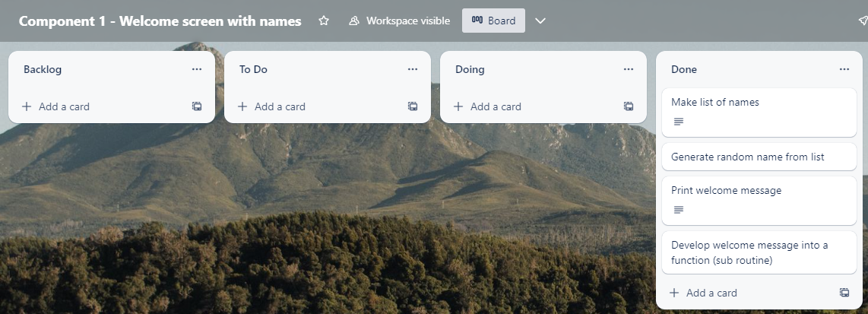
Component 1 (Trello screenshot)
Version 1
Version 2

Slide 5
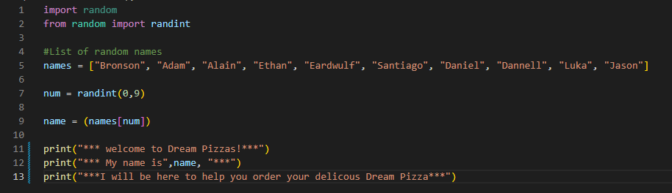
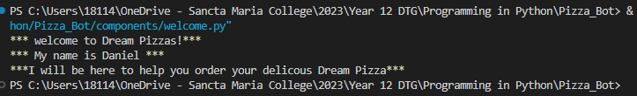
Component 1 Version 1 - Test Plan (?and screenshot)
Test Case | Expected Values
Ran program | Print welcome message with random name from name list – Runs correctly

Slide 6
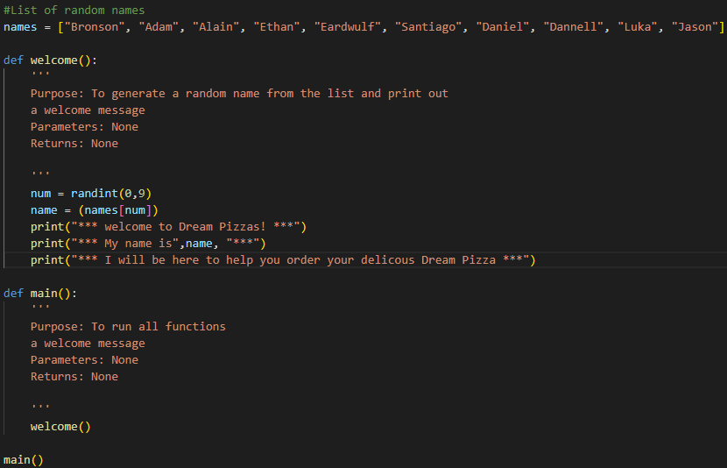
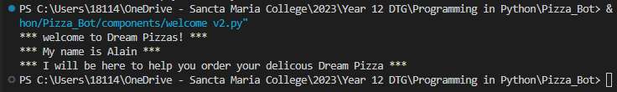
Component 1 Version 2 - Test Plan (?and screenshot)
Test Case | Expected Values
Ran program | Main and welcome run correctly. Welcome message prints with random name

Slide 7
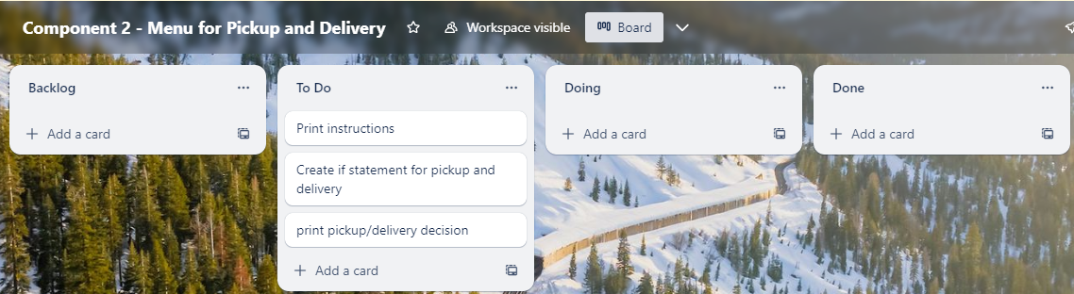
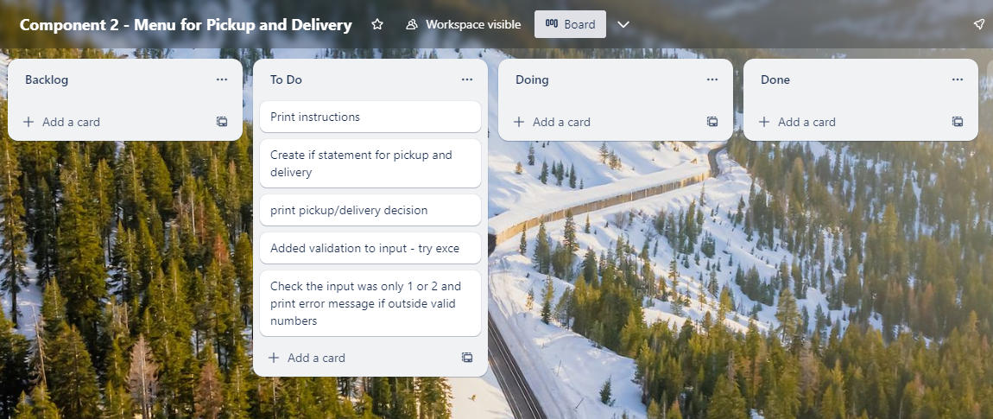
Component 2 (Trello screenshot)
Version 1
Version 2

Slide 8
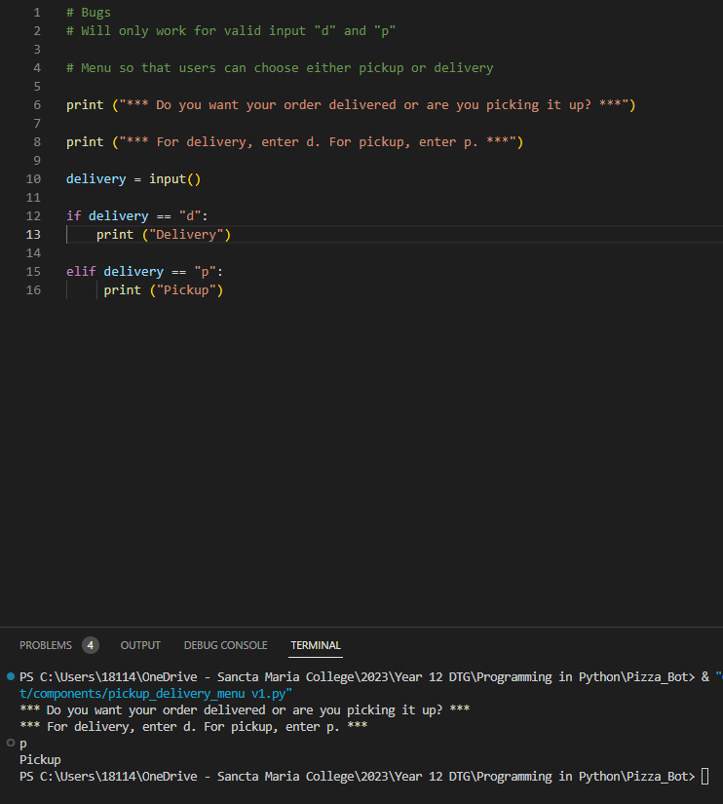
Component 2 Version 1 - Test Plan (?and screenshot)
Test Case | Expected Values
Ran program | Entered p – Program prints pickup Entered d – Program prints delivery Enter invalid – Program stops

Slide 9
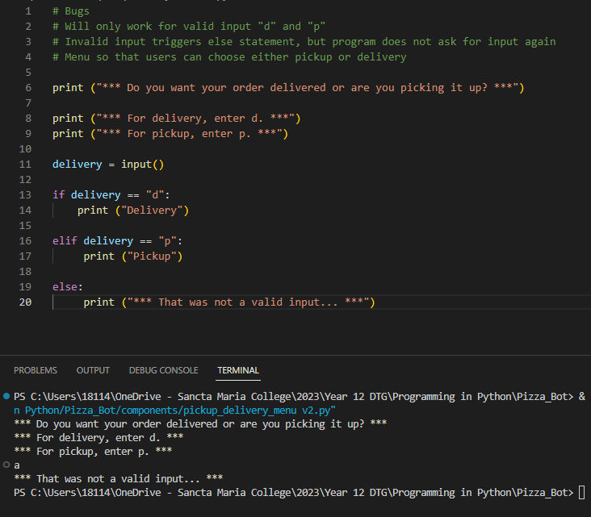
Component 2 Version 2 - Test Plan (?and screenshot)
Test Case | Expected Values
Ran program | Entered p – Program prints pickup Entered d – Program prints delivery Enter invalid – Program prints error message

Slide 10
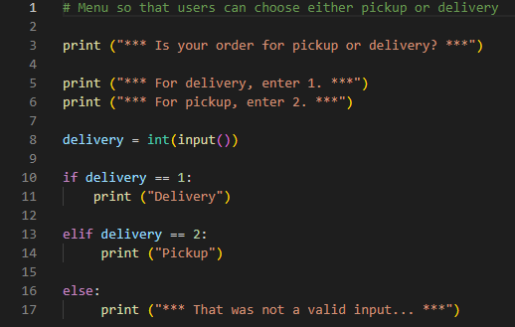
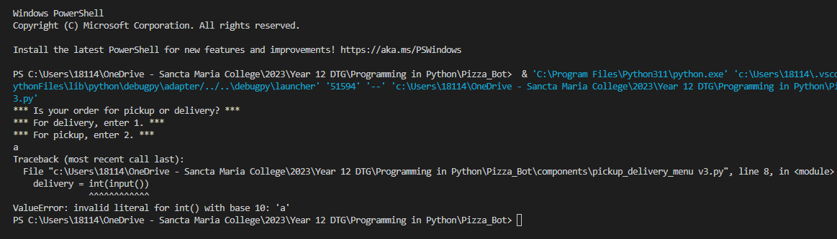
Component 2 Version 3 - Test Plan (?and screenshot)
Test Case | Expected Values
Ran program | Entered 1 – Program prints pickup Entered 2 – Program prints delivery Enter invalid – Program displays value error

Slide 11
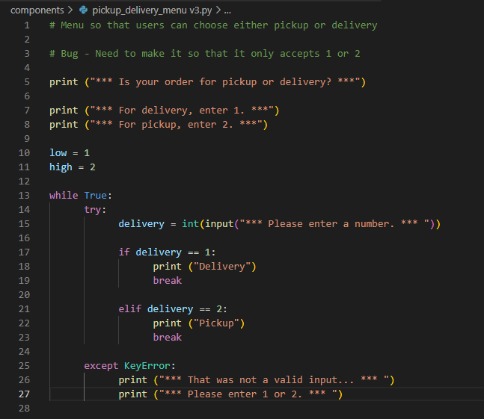
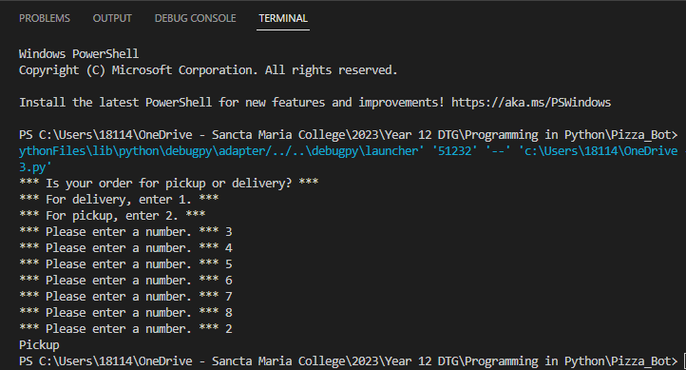
Component 2 Version 4 - Test Plan (?and screenshot)
Test Case | Expected Values
Ran program | Entered 1 – Program prints pickup Entered 2 – Program prints delivery Enter invalid – Program displays value error Enter number other than 1 or 2 does not work

Slide 12
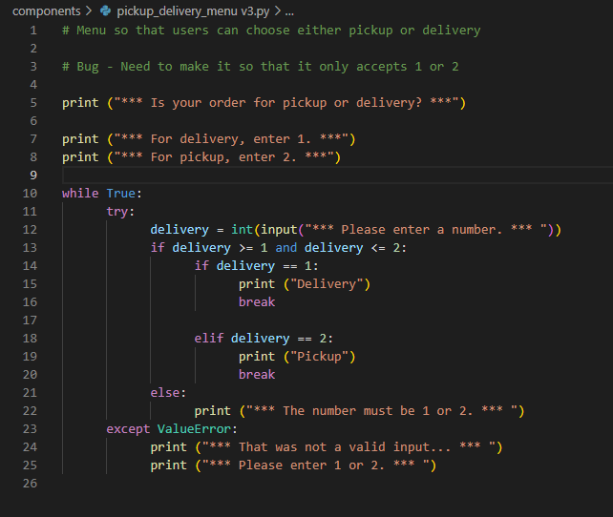
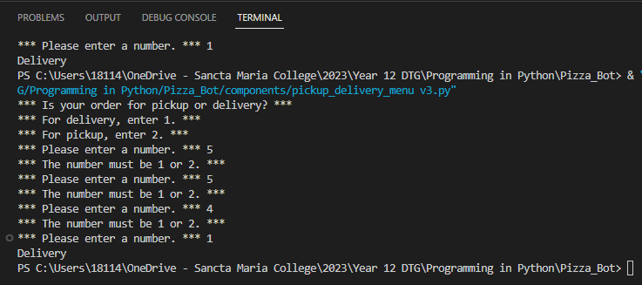
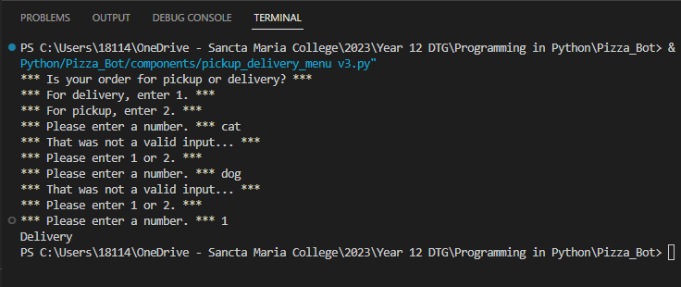
Component 2 Version 5 - Test Plan (?and screenshot)
Test Case | Expected Values
Ran program | Entered 1 – Program prints pickup Entered 2 – Program prints delivery Enter invalid – Error message asks for input again Enter number other than 1 or 2 – Error message asks for entry again

Slide 13
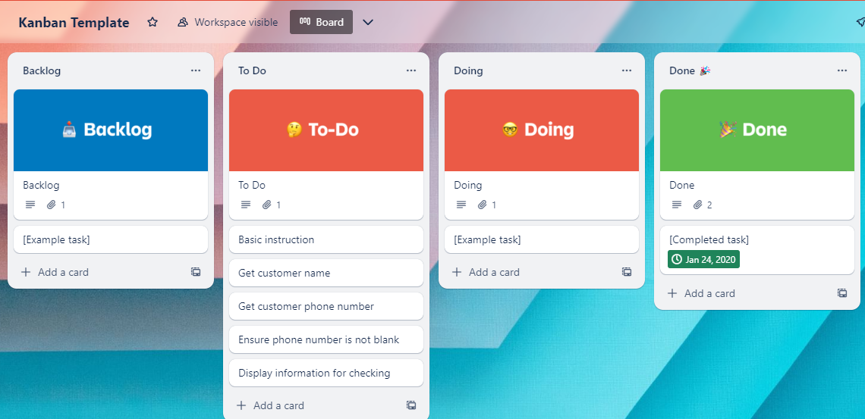
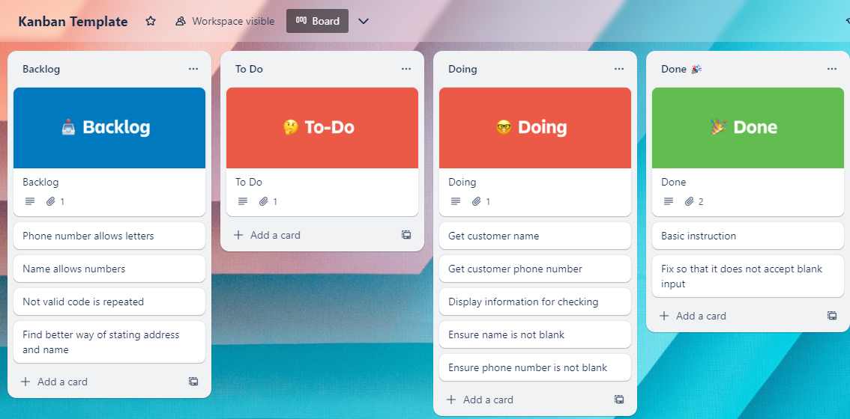
Component 3 – Pickup information (Trello screenshot)
Version 1
Version 2

Slide 14
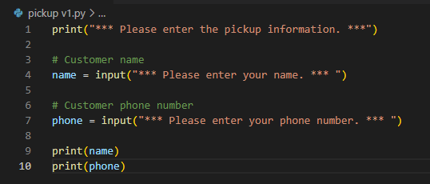
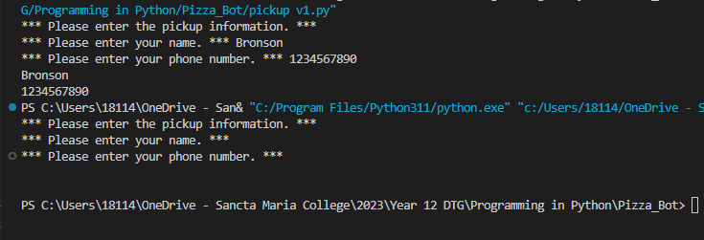
Component 3 Version 1 - Test Plan (?and screenshot)
Test Case | Expected Values
Input name Input phone number Left input blank | Printed name correctly. Printed phone number correctly. Accepted blank and printed blank input.

Slide 15
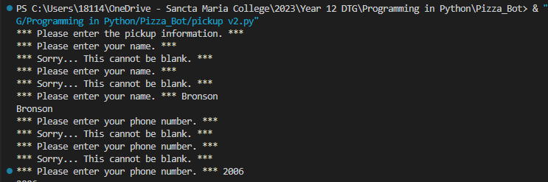
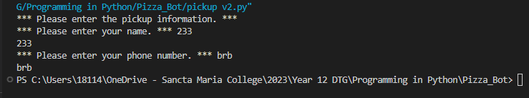
Component 3 Version 2 - Test Plan (?and screenshot)
Test Case | Expected Values
Input name Input phone number Left input blank | Printed name correctly. Printed phone number correctly. Prints "Sorry... This cannot be blank," and goes back to input.

Slide 16
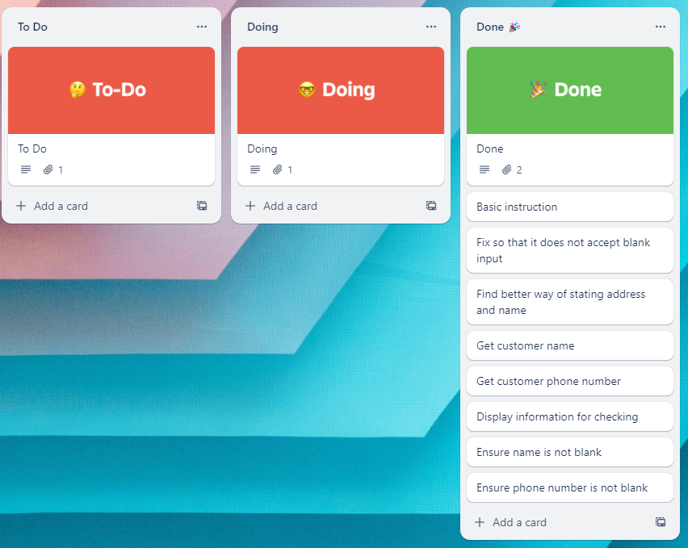
Component 3 – Pickup information (Trello screenshot)
Version 3

Slide 17
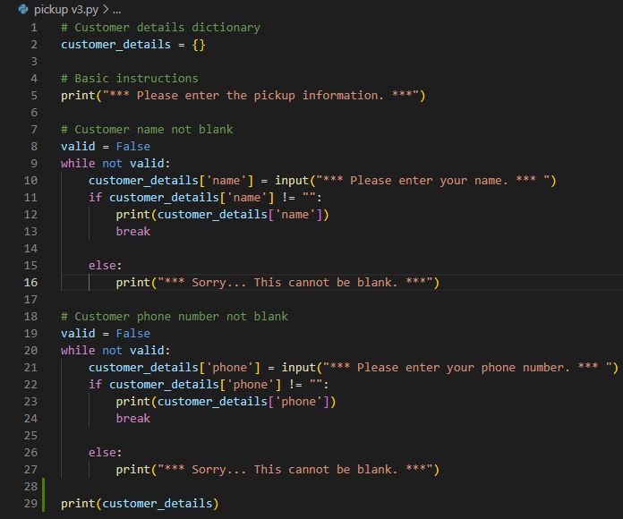
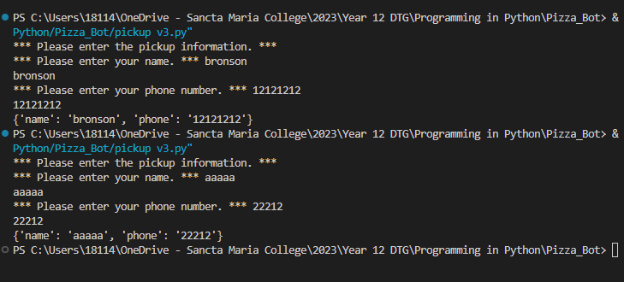
Component 3 Version 3 - Test Plan (?and screenshot)
Test Case | Expected Values
Input name Input phone number Left input blank | Printed name correctly. Printed phone number correctly. Prints "Sorry... This cannot be blank," and goes back to input.

Slide 18
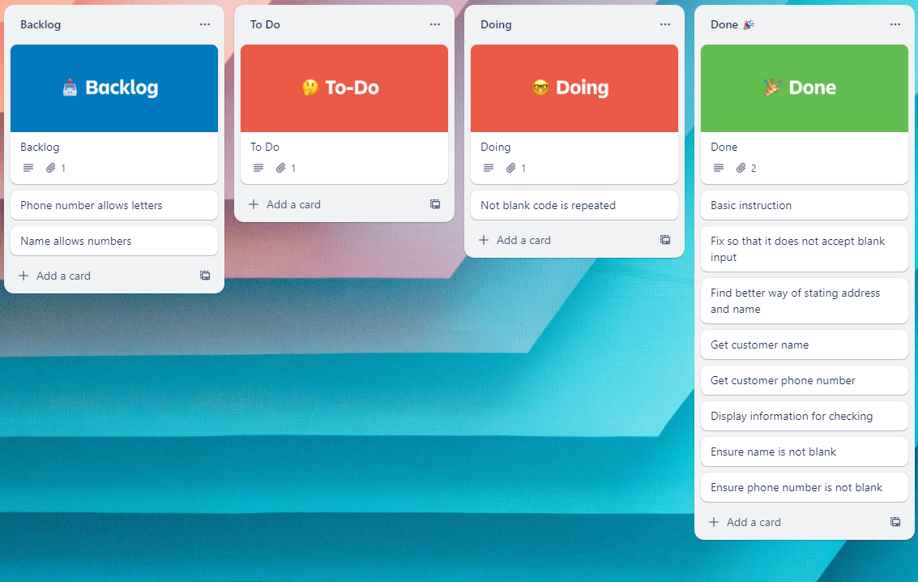
Component 3 – Pickup information (Trello screenshot)
Version 4

Slide 19
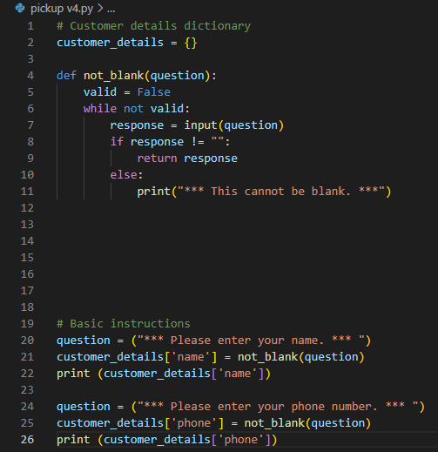
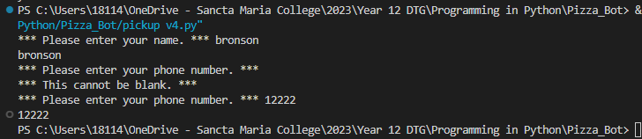
Component 3 Version 4 - Test Plan (?and screenshot)
Test Case | Expected Values
Input name Input phone number Left input blank | Printed name correctly. Printed phone number correctly. Prints "Sorry... This cannot be blank," and goes back to input.

Slide 20
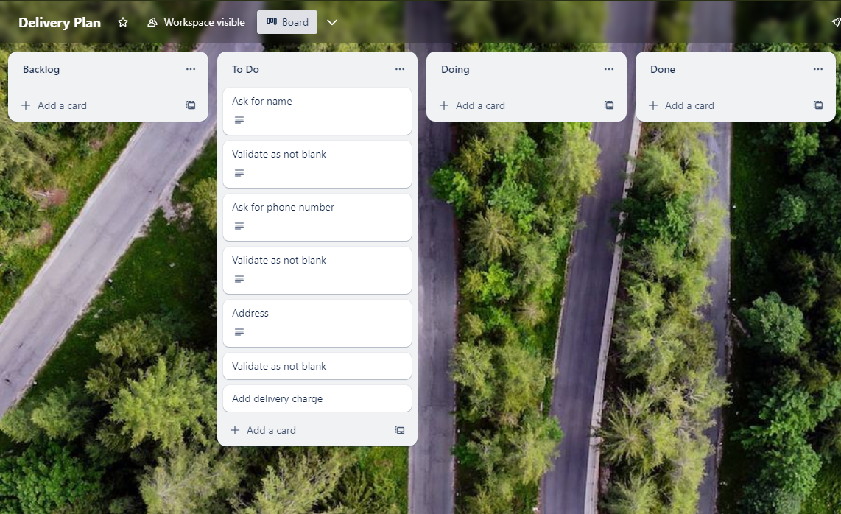
Component 4 – Delivery information (Trello screenshot)
Version 1

Slide 21
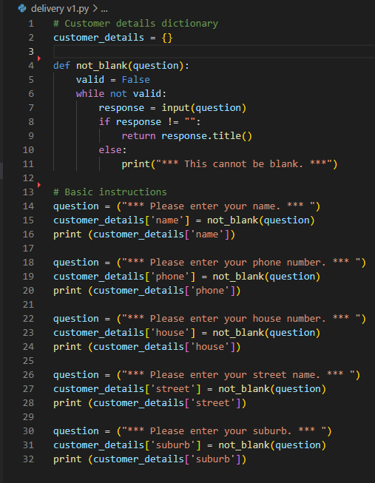
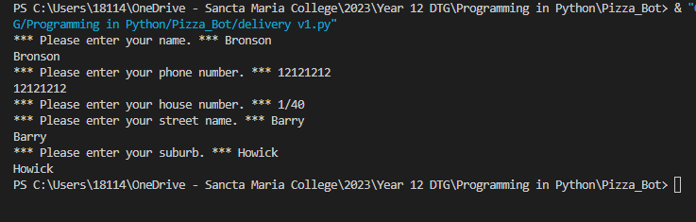
Component 4 Version 1 - Test Plan (?and screenshot)
Test Case | Expected Values
Input name Input phone number Input house number Input street name Input suburb Left input blank | Printed name correctly. Printed phone number correctly. Printed house number correctly. Printed street name correctly. Printed suburb correctly. Accepted blank and printed blank input. Asked for input again.

Slide 22
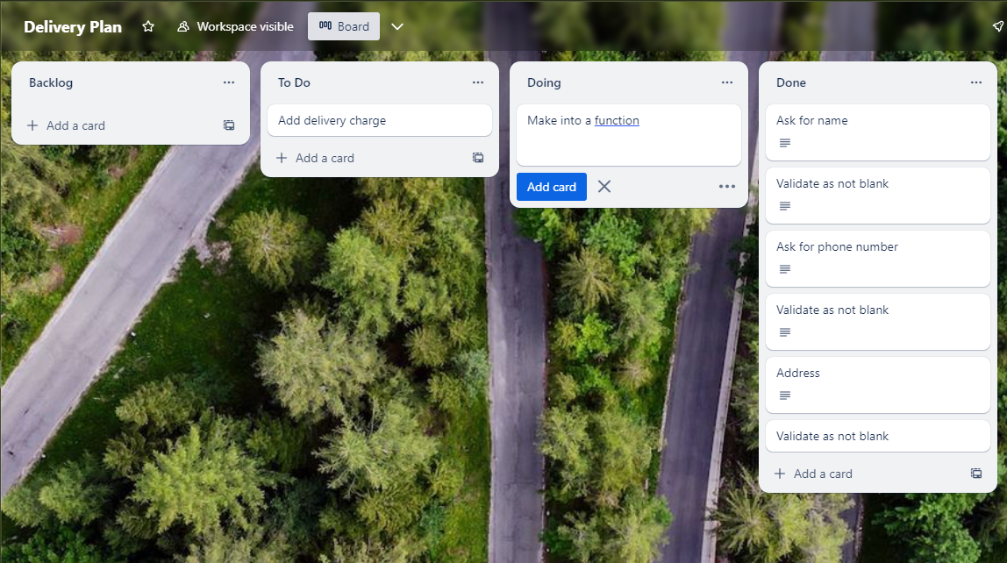
Component 4 – Delivery information (Trello screenshot)
Version 2

Slide 23
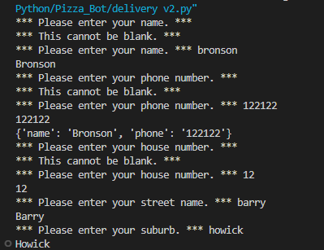
Component 4 Version 2 - Test Plan (?and screenshot)
Test Case | Expected Values
Input name Input phone number Input house number Input street name Input suburb Left input blank | Printed name correctly. Printed phone number correctly. Printed house number correctly. Printed street name correctly. Printed suburb correctly. Asked for input again.

Slide 24
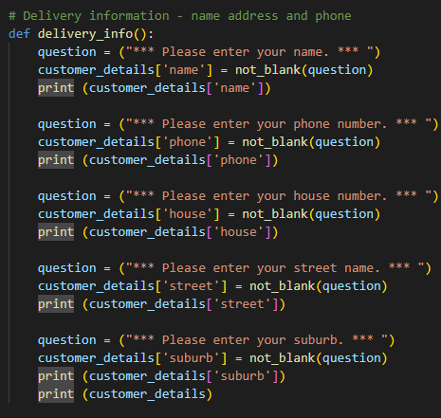
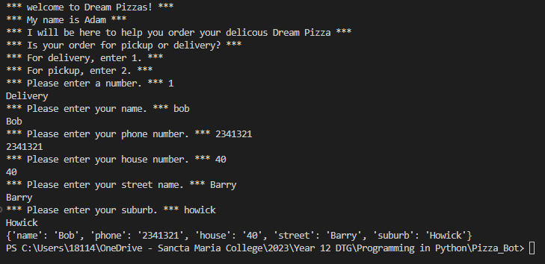
Component 4 Version 2 - Test Plan (?and screenshot)
Test Case | Expected Values
Input name Input phone number Input house number Input street name Input suburb Left input blank | Printed name correctly. Printed phone number correctly. Printed house number correctly. Printed street name correctly. Printed suburb correctly. Asked for input again.

Slide 25
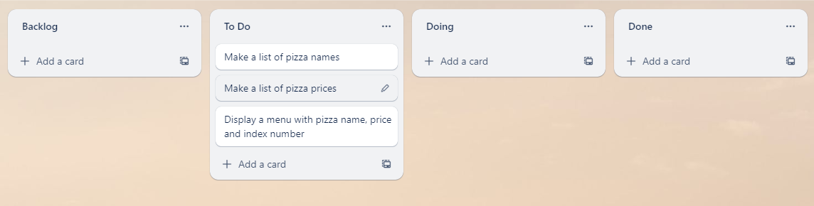
Component 5 – Pizza Menu (Trello screenshot)
Version 1

Slide 26
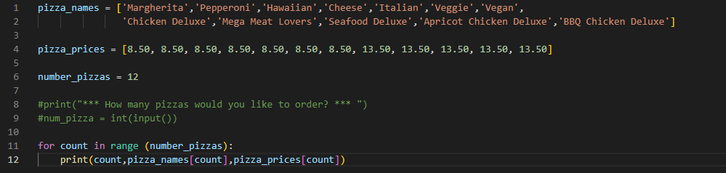
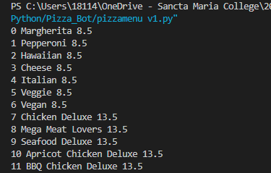
Component 5 Version 1 - Test Plan (?and screenshot)
Test Case | Expected Values
Run file | Printed list with index number, pizzas and prices

Slide 27
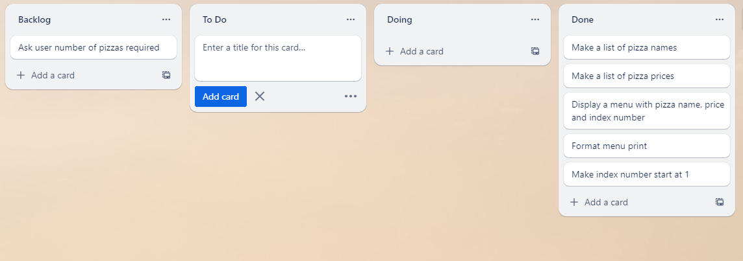
Component 5 – Pizza Menu (Trello screenshot)
Version 2

Slide 28
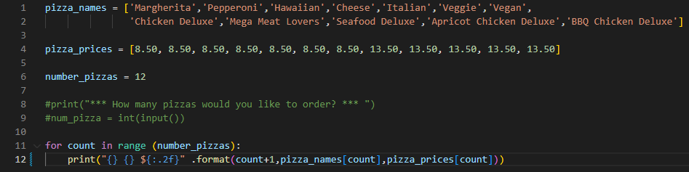
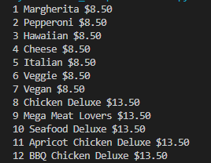
Component 5 Version 2 - Test Plan (?and screenshot)
Test Case | Expected Values
Run file | Printed list with index number, pizzas and prices with price formated to 2 decimal places and dollar sign. Menu starts at 1.

Slide 29
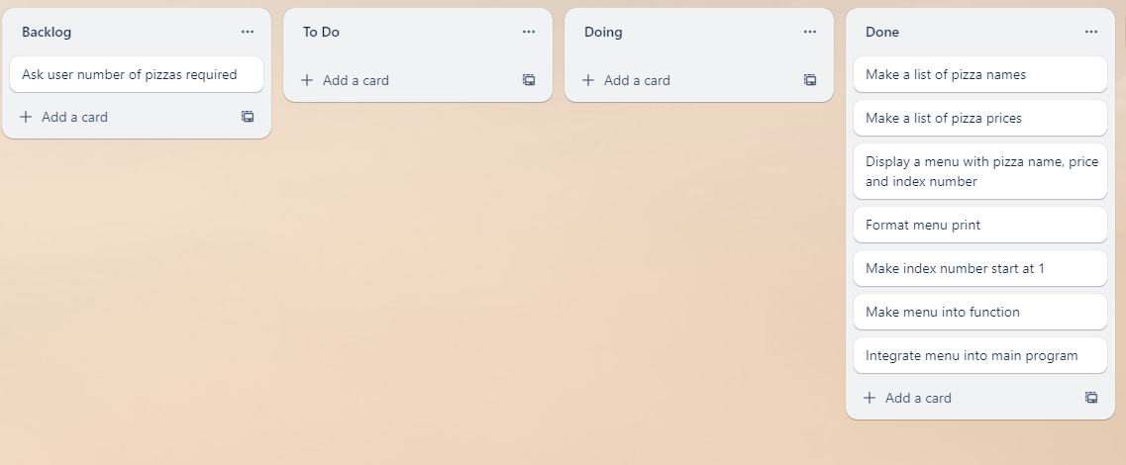
Component 5 – Pizza Menu (Trello screenshot)
Version 3

Slide 30
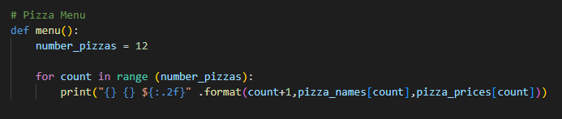
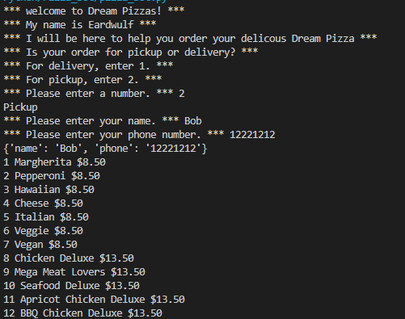
Component 5 Integrated into main program - Test Plan (?and screenshot)
Test Case | Expected Values
Run file | Printed list with index number, pizzas and prices with price formated to 2 decimal places and dollar sign. Menu starts at 1.

Slide 31
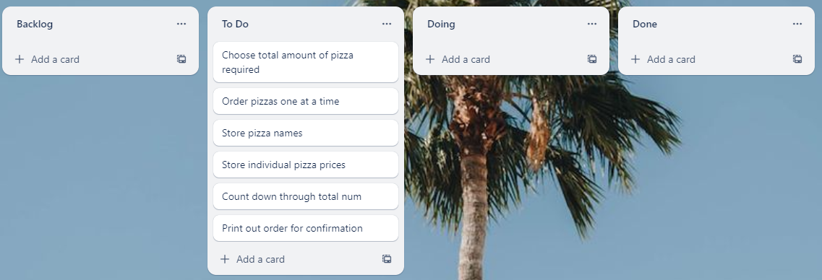
Component 6 – Pizza Order (Trello screenshot)
Version 1

Slide 32
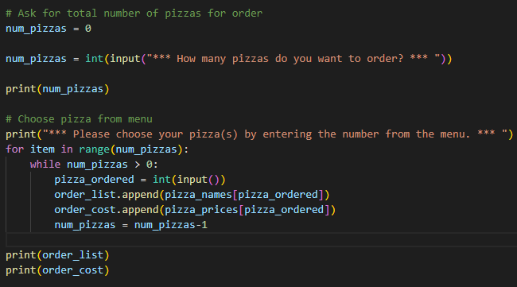
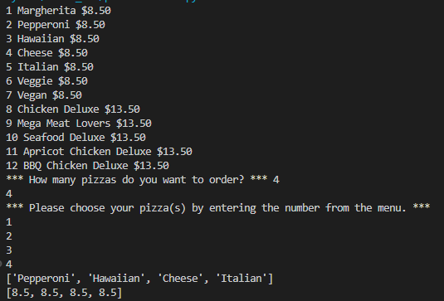
Component 6 Version 1 - Test Plan (?and screenshot)
Test Case | Expected Values
Entered 4 pizzas Entered cat | Stepped through menu choice 4 times. Program broke

Slide 33
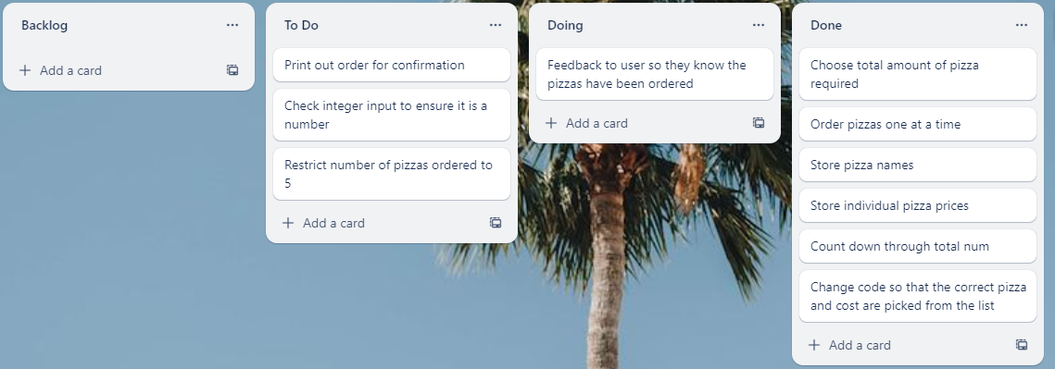
Component 6 – Pizza Order (Trello screenshot)
Version 2

Slide 34


Component 6 Version 2 - Test Plan (?and screenshot)
Test Case | Expected Values
Input invalid Input numbers under 1 or over 5 Input numbers over 1 or under 5 | Prints "That is not a valid number" and repeats input. Prints "Your order must be between 1 and 5" and repeats input. Breaks input and moves on to menu choice.

Slide 35

Component 6 – Pizza Order (Trello screenshot)
Version 3

Slide 36


Component 6 Version 3 - Test Plan (?and screenshot)
Test Case | Expected Values
Input invalid Input numbers under 1 or over 12 Input numbers over 1 or under 12 | Prints "That is not a valid number" and repeats input. Prints "Your order must be between 1 and 12" and repeats input. Steps through menu choice 4 times.

Slide 37

Component 6 – Pizza Order (Trello screenshot)
Version 4

Slide 38

Component 6 Version 4 - Test Plan (?and screenshot)
Test Case | Expected Values
Input invalid Input numbers under 1 or over 12 Input numbers over 1 or under 12 | Prints "That is not a valid number" and repeats input. Prints "Your order must be between 1 and 12" and repeats input. Steps through menu choice 4 times.

Slide 39

Component 6 – Pizza Order (Trello screenshot)
Version 5

Slide 40


Component 6 Main Program - Test Plan (?and screenshot)
Test Case | Expected Values
Input invalid Input numbers under 1 or over 12 Input numbers over 1 or under 12 | Prints "That is not a valid number" and repeats input. Prints "Your order must be between 1 and 12" and repeats input. Steps through menu choice 4 times.

Slide 41

Component 7 – Order Print (Trello screenshot)
Version 1

Slide 42


Component 7 Version 1 - Test Plan (?and screenshot)
Test Case | Expected Values
Ran with test data | Prints correctly.

Slide 43

Component 7 – Order Print (Trello screenshot)
Version 2 - 4

Slide 44


Component 7 Version 2 - Test Plan (?and screenshot)
Test Case | Expected Values
Ran with test data | Prints correctly. Requires further formatting.

Slide 45

Component 7 Version 3 - Test Plan (?and screenshot)
Test Case | Expected Values
Ran with test data | Prints correctly. Requires further formatting.

Slide 46

Component 7 Version 4 - Test Plan (?and screenshot)
Test Case | Expected Values
Ran with test data | Prints details on separate page with formatting.

Slide 47

Component 7 – Order Print (Trello screenshot)
Version 5

Slide 48


Component 7 Version 4 - Test Plan (?and screenshot)
Test Case | Expected Values
Ran with test data | Prints details on separate lines with formatting.

Slide 49

Component 7 – Order Print (Trello screenshot)
Version 6

Slide 50



Component 7 Version 6 - Test Plan (?and screenshot)
Test Case | Expected Values
Choose pickup Choose delivery | Works – prints name and phone. Slightly works – prints name, phone and address. Though, does not apply delivery charge.

Slide 51

Component 7 – Order Print (Trello screenshot)
Version 7

Slide 52


Component 7 Main Program - Test Plan (?and screenshot)
Test Case | Expected Values
Choose pickup Choose delivery | Works – prints name and phone. No pick up charge added. Works – prints name, phone, address and $5.00 delivery charge.

Slide 53

Component 8 – Confirm or Cancel Order Function (Trello screenshot)
Version 1

Slide 54


Component 8 Version 1 - Test Plan (?and screenshot)
Test Case | Expected Values
Entered 1 – Chose confirm Entered 2 – Chose cancel Entered 4 Entered invalid input. | Works – prints confirm. Works – prints cancel. Prints "please enter 1 or 2." Prints "that was not a valid input..."

Slide 55

Component 8 – Confirm or Cancel Order Function (Trello screenshot)
Version 2

Slide 56



Component 8 Version 2 - Test Plan (?and screenshot)
Test Case | Expected Values
Entered 1 – Chose confirm Entered 2 – Chose cancel Entered 4 Entered invalid input. | Works – prints confirm. Works – prints cancel. Prints "please enter 1 or 2." Prints "that was not a valid input..."

Slide 57

Component 9 – New Order or Exit Program (Trello screenshot)
Version 1

Slide 58


Component 9 Version 1 - Test Plan (?and screenshot)
Test Case | Expected Values
Entered 1 – Chose confirm Entered 2 – Chose cancel Entered 0 Entered invalid input. | Works – prints new order. *Data remains in the order. Works – prints exit BOT. *Data remains in the order. Prints "please enter 1 or 2." Prints "that was not a valid input..." *Will need to clear the data from these lists.

Slide 59

Component 9 – New Order or Exit Program (Trello screenshot)
Version 2

Slide 60


Component 9 Version 2 - Test Plan (?and screenshot)
Test Case | Expected Values
Entered 1 – Chose confirm Entered 2 – Chose cancel | Works – prints new order. *Data remains in the order. Works – prints exit BOT. *Data remains in the order. *Will need to clear the data from these lists.

Slide 61
Version Control Evidence
Your version control evidence should go here. This could be in the form of annotated screenshots which show you you managed this process or you could make a brief screencast explaining how you implemented version control.
Notes:
Your version control evidence should go here. This could be in the form of annotated screenshots which show you you managed this process or you could make a brief screencast explaining how you implemented version control.

Slide 62
Discusses how the information from planning, testing and trialling of components assisted in the development of a high-quality outcome
Notes:
Discusses how the information from planning, testing and trialling of components assisted in the development of a high-quality outcome

